Slide 1
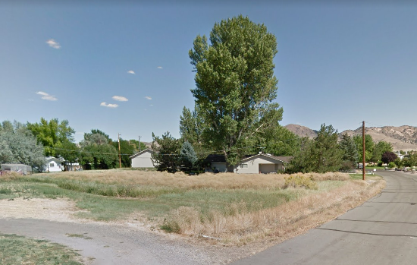
WADMIN19-0005 Zweifel Garage Addition
Washoe County Board of Adjustment
May 2, 2019

Slide 2
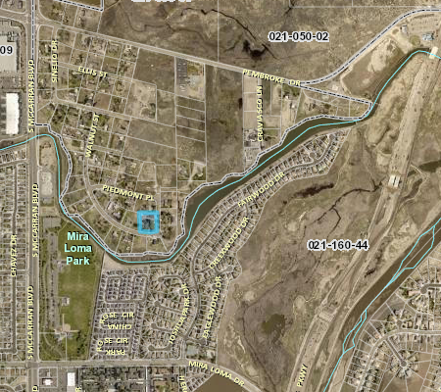
Overview
± 1 acre parcel
Suburban Residential
Single family dwelling
Shop/garage
Surrounding property owners voiced support at the CAB

Slide 3
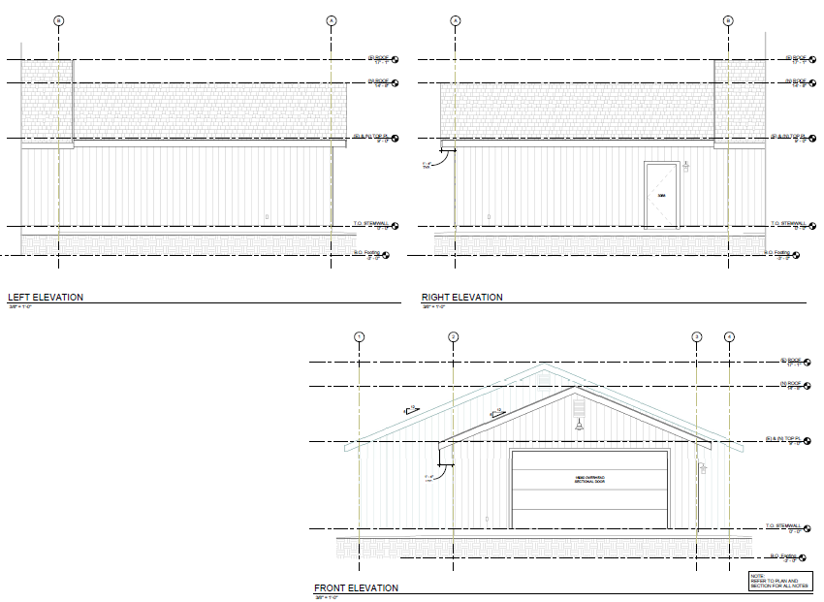
Elevations
Build on to existing garage, making foot print of accessory structure larger than house

Slide 4
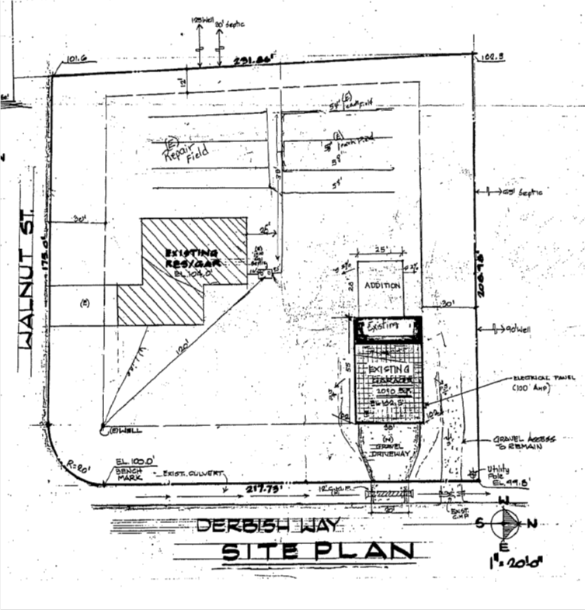
Site Plan
- Trees exist between the structure and the nearest property
- Applicant planted 20 additional trees

Slide 5
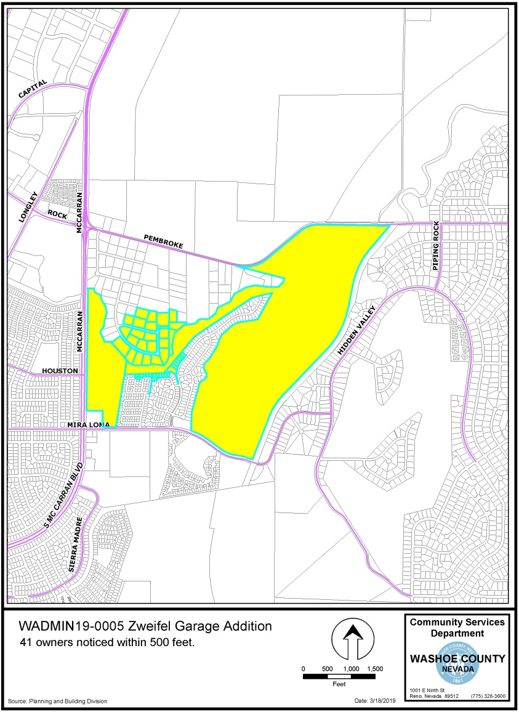
Public Notice & CAB
South Truckee Meadows/Washoe Valley CAB
41 property owners within 500 feet

Slide 6
Reviewing Agencies
Washoe County Community Service
  Planning and Building Division
  Engineering and Capital Projects
Washoe County Sheriff’s Office
Regional Transportation District
Truckee Meadows Fire Protection District
Washoe Storey Conservation District

Slide 7
Administrative Permit
1. Consistency
2. Improvements
3. Site Suitability
4. Issuance Not Detrimental

Slide 8
Possible Motion
I move that, after giving reasoned consideration to the information contained in the staff report and information received during the public hearing, the Board of Adjustment approve, with the Conditions of Approval included in Exhibit A to this matter, Administrative Permit Case Number WADMIN19-0005 for Jerry and Adrienne Zweifel Garage Addition, having made the four required findings in accordance with Washoe County Code Section 110.808.25:

